Slide 1
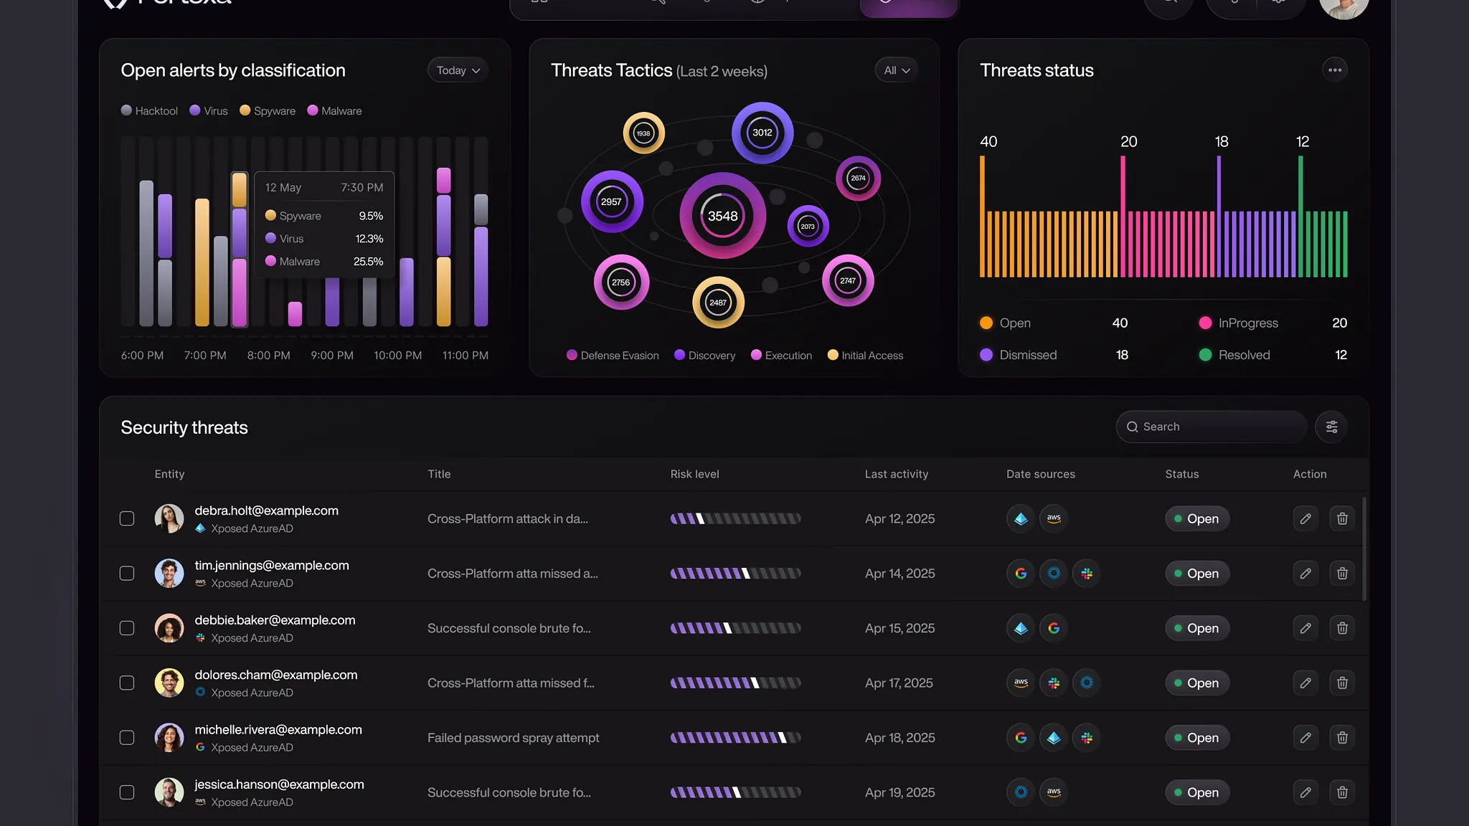
WEEK 4 PROGRESS UPDATE
Capstone Project
Progress Update
Design and Evaluation of a Deception-in-Depth
Honeynet Architecture for Observing Multi-Stage Attacker Behaviour
Mentor
Team Members
Timeline
Dr. Ho Chen
4 Students
Week 4 of 12

Slide 2
MEETING AGENDA
What We'll Cover Today
01
Project Overview
02
Completed Milestones
Research objectives, questions, and hypothesis
Week 1-4 deliverables and achievements
03
Progress Summary
04
Technical Architecture
Metrics, timeline status, and completion rate
Three-layer deception system design
05
Upcoming Milestones
06
Risk Assessment
Week 5-12 plan and deadlines
Key risks and mitigation strategies

Slide 3
PROJECT OVERVIEW
What We're Building
Primary Objective
Three Deception Layers
Design, implement, and evaluate a layered Deception-in-Depth honeynet architecture capable of observing multi-stage attacker behaviour across network, host, and data layers.
Layer 1
Network
T-Pot CE honeypot services (SSH, HTTP, SMB)
Experimental Approach
Deploy a controlled virtual environment on Proxmox VE with 5-6 VMs simulating a small enterprise network. Observe attacker interactions and measure behavioural impact using three key metrics.
Layer 2
Host
GOAD Active Directory + Windows enterprise hosts
Layer 3
Data
Key Behavioural Metrics
HoneyLambda + decoy S3 cloud credentials
01
02
03
Misdirection
Delay
Engagement
Deception Control Plane: Staged activation based on attacker actions
Decoy interactions
Time spent
Depth reached

Slide 4
RESEARCH FRAMEWORK
Research Questions & Hypothesis
RQ1
Attacker Navigation
Central Hypothesis
How does layered deception influence attacker navigation within the honeynet?
A staged Deception-in-Depth architecture will encourage attackers to interact more extensively with deceptive assets and explore more layers than a single-layer honeypot.
RQ2
Decision Influence
To what extent do deception artifacts influence attacker decisions?
Increase engagement depth across multiple hosts
Influence attacker navigation through artifacts
RQ3
Engagement Depth
Introduce delays in attacker progression
Does staged activation of deception layers increase engagement?
RQ4
Time Impact
MITRE ATT&CK Mapping
How does layered deception affect time attackers spend interacting?
Observed activities mapped to structured tactics:
Activity Patterns
Reconnaissance
Credential Access
Lateral Movement
Collection
RQ5
What activities are observed across different attack lifecycle stages?
Exfiltration

Slide 5
TECHNICAL DESIGN
Three-Layer Deception Architecture
L1
Network
L2
Host
L3
Data/Cloud
Initial Access
Lateral Movement
Exfiltration
Components
Components
Components
• T-Pot CE platform
• GOAD Active Directory
• HoneyLambda
• SSH, HTTP, SMB services
• Windows clients & servers
• Decoy S3 buckets
• Simulated subnets
• Domain controller
• Fake API keys
MITRE ATT&CK
MITRE ATT&CK
MITRE ATT&CK
Reconnaissance
Credential Access
Privilege Escalation
Lateral Movement
Collection
Exfiltration
Expected Behaviour
Expected Behaviour
Expected Behaviour
Scanning, credential brute force
Enumeration, credential harvesting
Credential reuse, cloud enumeration
Telemetry Flow
Deception Control Plane
All layers → LOG01 (centralized monitoring) → Normalization → Structured datasets → Behavioural analysis
Conditional layer activation based on attacker triggers: login success → command execution → credential interaction

Slide 6
COMPLETED MILESTONE
Milestone 1: Literature Review
Key Research Findings
COMPLETED
Milestone Details
Landsborough et al. (2024)
Timeline
Week 1-2
Deception-in-Depth strategy with three logical layers (network, host, data). Single-layer deception may be insufficient as attackers can detect isolated honeypots.
Learning Hours
30
Gaddam (2025)
Status
Complete
Deception techniques increase attacker effort and improve visibility into attacker behaviour patterns.
Key Concepts Covered
Fraunholz et al. (2021)
Adaptive deployment and dynamic configuration are crucial for responding to attacker activity in honeynet systems.
Encouraging vs. discouraging deception
Multi-layered deception architectures
Attacker behaviour influence
Honeynet deployment strategies
Research Gap Identified
Controlled experimentation
Despite advances in cyber deception, there remains a gap in experimentally evaluating how layered deception influences attacker behaviour across multiple stages within controlled and reproducible environments.
Completed
Week 2

Slide 7
COMPLETED MILESTONE
Milestone 2: Architecture Design
System Architecture Overview
COMPLETED
Milestone Details
Network Deception Layer
Timeline
Week 3
L1
T-Pot CE platform with SSH, HTTP, SMB services
Learning Hours
25
T-Pot CE
SSH
HTTP
Status
Complete
L2
Host Deception Layer
GOAD Active Directory + Windows enterprise hosts
GOAD
AD
Windows
5-VM Deployment Layout
LOG01
4GB RAM
L3
Data Deception Layer
HoneyLambda + decoy S3 buckets with fake API keys
TPOT01
8GB RAM
HoneyLambda
S3
API Keys
DC01
6GB RAM
WS01
4GB RAM
Deception Control Plane
FS01
4GB RAM
Conditional activation system that exposes deeper layers based on attacker actions (login success, command execution, credential interaction).
Total RAM
26 GB
Completed
Week 3

Slide 8
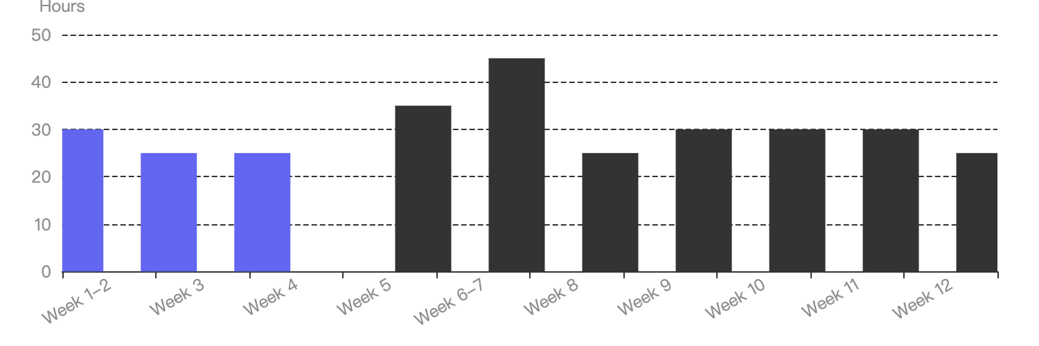
PROGRESS OVERVIEW
30% Complete — On Track
3/10
80/300
4/12
Completion Status
Milestones
Learning Hours
Weeks
Overall Progress
30%
Completed
Invested (26.7%)
Elapsed (33.3%)
Time Elapsed
33.3%
Project Timeline Progress
Hours Invested
26.7%
Key Achievements
Literature review completed with key findings
Three-layer architecture designed
Proxmox environment operational
5 VMs deployed and configured
Network segmentation established
On Schedule
All deliverables met on time

Slide 9
COMPLETED MILESTONE
Milestone 3: Proxmox Environment Setup
Deployment Platform
COMPLETED
Milestone Details
Timeline
Week 4
32 GB
SSD
Learning Hours
25
Total RAM
Storage
Status
Complete
Platform
Proxmox VE
Deployment Model
Isolated Virtual Lab
5 Core VMs Deployed
LOG01
Reset Mechanism
Snapshots & Rollback
Monitoring & Logging
TPOT01
Network Honeypot
Network Segmentation
DC01
NET-EXT
External
Domain Controller
Attacker-facing services (TPOT01)
WS01
Workstation
NET-INT
Internal
Enterprise network (DC01, WS01, FS01)
FS01
File Server
NET-MGMT
Management
Admin & logging (LOG01)
Completed
Week 4

Slide 10
UPCOMING WORK
Milestones: Week 5–7
WEEK
Milestone 4: Network Honeypot Deployment
UPCOMING
5
Learning Hours
Primary Tool
Focus
35
T-Pot CE
Service Config
SSH honeypot
Web honeypot
Banner tuning
Credential seeding
WEEK
Milestone 5: Host-Level Environment Setup
UPCOMING
6-7
Learning Hours
Primary Tool
Focus
45
GOAD
AD + Hosts
Active Directory
Domain controller
Workstation setup
Decoy accounts
WEEK
Milestone 6: Deception Artifact Implementation
UPCOMING
8
Learning Hours
Focus
Scope
25
Artifacts
All Layers
Fake credentials
Decoy documents
API keys
Cloud references

Slide 11
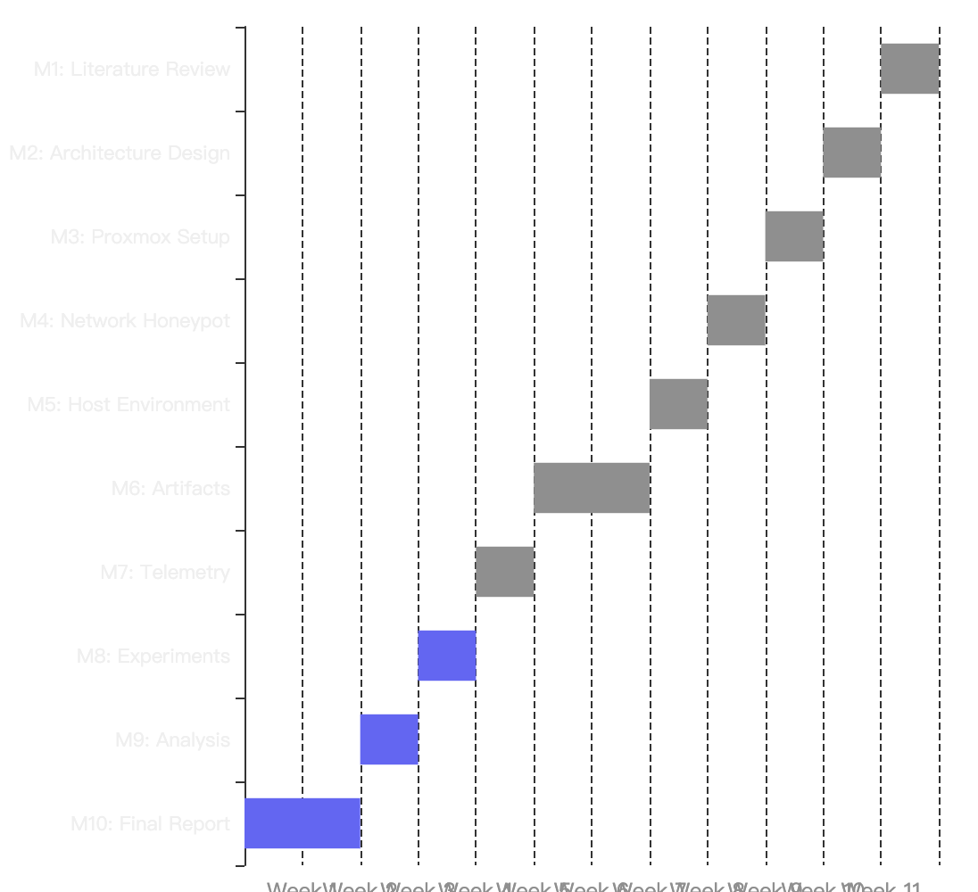
UPCOMING WORK
Milestones: Week 9–12
W9
Milestone 7
UPCOMING
Complete Project Timeline
Telemetry Pipeline
Hours
Output
30
Structured Logs
W10
Milestone 8
UPCOMING
Experiment Execution
Hours
Scenarios
30
A, B, C
W11
Milestone 9
UPCOMING
Behavioural Analysis
Hours
Output
30
Metrics + Paths
W12
Milestone 10
UPCOMING
Final Report
Hours
Output
25
Capstone Report

Slide 12
RISK MANAGEMENT
Risk Assessment & Mitigation
RAM Pressure Risk
Logging Scope Management
Running multiple VMs simultaneously may exceed 32GB capacity
Centralized telemetry can become overwhelming if scope is too broad
Mitigation
Mitigation
• Use 5-VM baseline (26GB)
• Collect only metrics-relevant logs
• Defer optional VM6 (ADM01)
• Focus on 3 behavioural indicators
• Monitor resource usage
• Use lightweight processing
AD Lab Complexity
Experiment Reproducibility
Domain-based environments can be difficult to build manually
Without reset capability, repeated tests may become inconsistent
Mitigation
Mitigation
• Use GOAD as base template
• Proxmox snapshots as core workflow
• Limit modifications to deception
• Clean + experiment-ready states
• Document configuration steps
• Documented reset procedures
All Risks Manageable
Mitigation strategies in place. Project remains feasible within capstone timeframe and resource constraints.

Slide 13
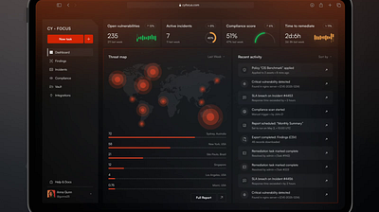
PROJECT STATUS: ON TRACK
Next Steps & Questions
Immediate Next Step
Begin Milestone 4: Network Honeypot Deployment in Week 5
T-Pot CE configuration, service banner tuning, credential seeding (35 hours)
30%
8
220
Complete
Weeks Remaining
Hours Planned
Project on track for Week 12 completion
All milestones achievable within allocated learning hours and timeline
Thank You
Open for feedback and questions

